Slide 1
Machine Learning in Healthcare
Juan Quiroz
Australian Institute of Health Innovation
Notes:
Hello everybody,
My name is Juan and I’m a research fellow at the Australian Institute of Health Innovation.
First things first, who am I and what do I do?

Slide 2
What do I do?
AI for healthcare applications
Use AI to reduce the documentation burden of doctors
Digital scribe

Slide 3
Digital Scribe
Digital Scribe
Patient Notes
Automatic speech recognition
Natural language processing
Automatic summarization
Notes:
So that’s a little about me.
So what am I here to share with you?
I’m here to talk about
Why am I here?

Slide 4
Notes:
My boss has this vision of a patient walking into a smart room, where the room listens to the conversation between the patient and the doctor, and functions as an assistant to the doctor, any measurements that the doctor takes are automatically recorded by the room.
But we are very far from that.

Slide 5

Machine Learning?
Notes:
About machine learning
When people outside of the field, ask me to describe and explain machine learning, I really struggle with it.
I end up relying on examples.

Slide 6
Notes:
Amazon recommendations
Spam filters
Targeted advertising
Friends suggestions in social media
Google translate
Self-driving cars
Netflix movie recommendations

Slide 7
Artificial Intelligence
Machine Learning
Deep Learning

Slide 8
Today
Examples of machine learning in health care
Brief introduction to machine learning
Discuss some machine learning models
Machine learning fails
Singularity
Notes:
About machine learning
When people outside of the field, ask me to describe and explain machine learning, I really struggle with it.
I end up relying on examples.

Slide 9
1-Minute Summary
Machine learning recipe: data + labels + model
Model is math, a mapping from input to output, linear algebra, calculus, probability
Many models: least squares, logistic regression, decision tree, neural networks, deep learning
Machine learning in healthcare is very good for visual tasks

Slide 10
Machine Learning in Healthcare

Slide 11
Diabetic Retinopathy Diagnosis
Gulshan et al.“Development and Validation of a Deep Learning Algorithm for Detection of Diabetic Retinopathy in Retinal Fundus Photographs.” JAMA 316, no. 22 (December 13, 2016): 2402–10. https://doi.org/10.1001/jama.2016.17216.

Slide 12
Diabetic Retinopathy Diagnosis
Deep Learning
Healthy

Slide 13
Detecting Breast Cancer Metastases from Pathology Images
Tumor patches
Normal
Liu, Yun, Krishna Gadepalli, Mohammad Norouzi, George E. Dahl, Timo Kohlberger, Aleksey Boyko, Subhashini Venugopalan, et al. “Detecting Cancer Metastases on Gigapixel Pathology Images.” ArXiv:1703.02442 [Cs], March 3, 2017. http://arxiv.org/abs/1703.02442.

Slide 14
Detecting Breast Cancer Metastases from Pathology Images
Deep Learning

Slide 15
Diagnosis of Alzheimer’s Disease from Neuroimaging
Liu et al. “Multimodal Neuroimaging Feature Learning for Multiclass Diagnosis of Alzheimer’s Disease.” IEEE Transactions on Biomedical Engineering 62, no. 4 (April 2015): 1132–40.

Slide 17
Classification of Skin Cancer

Slide 20
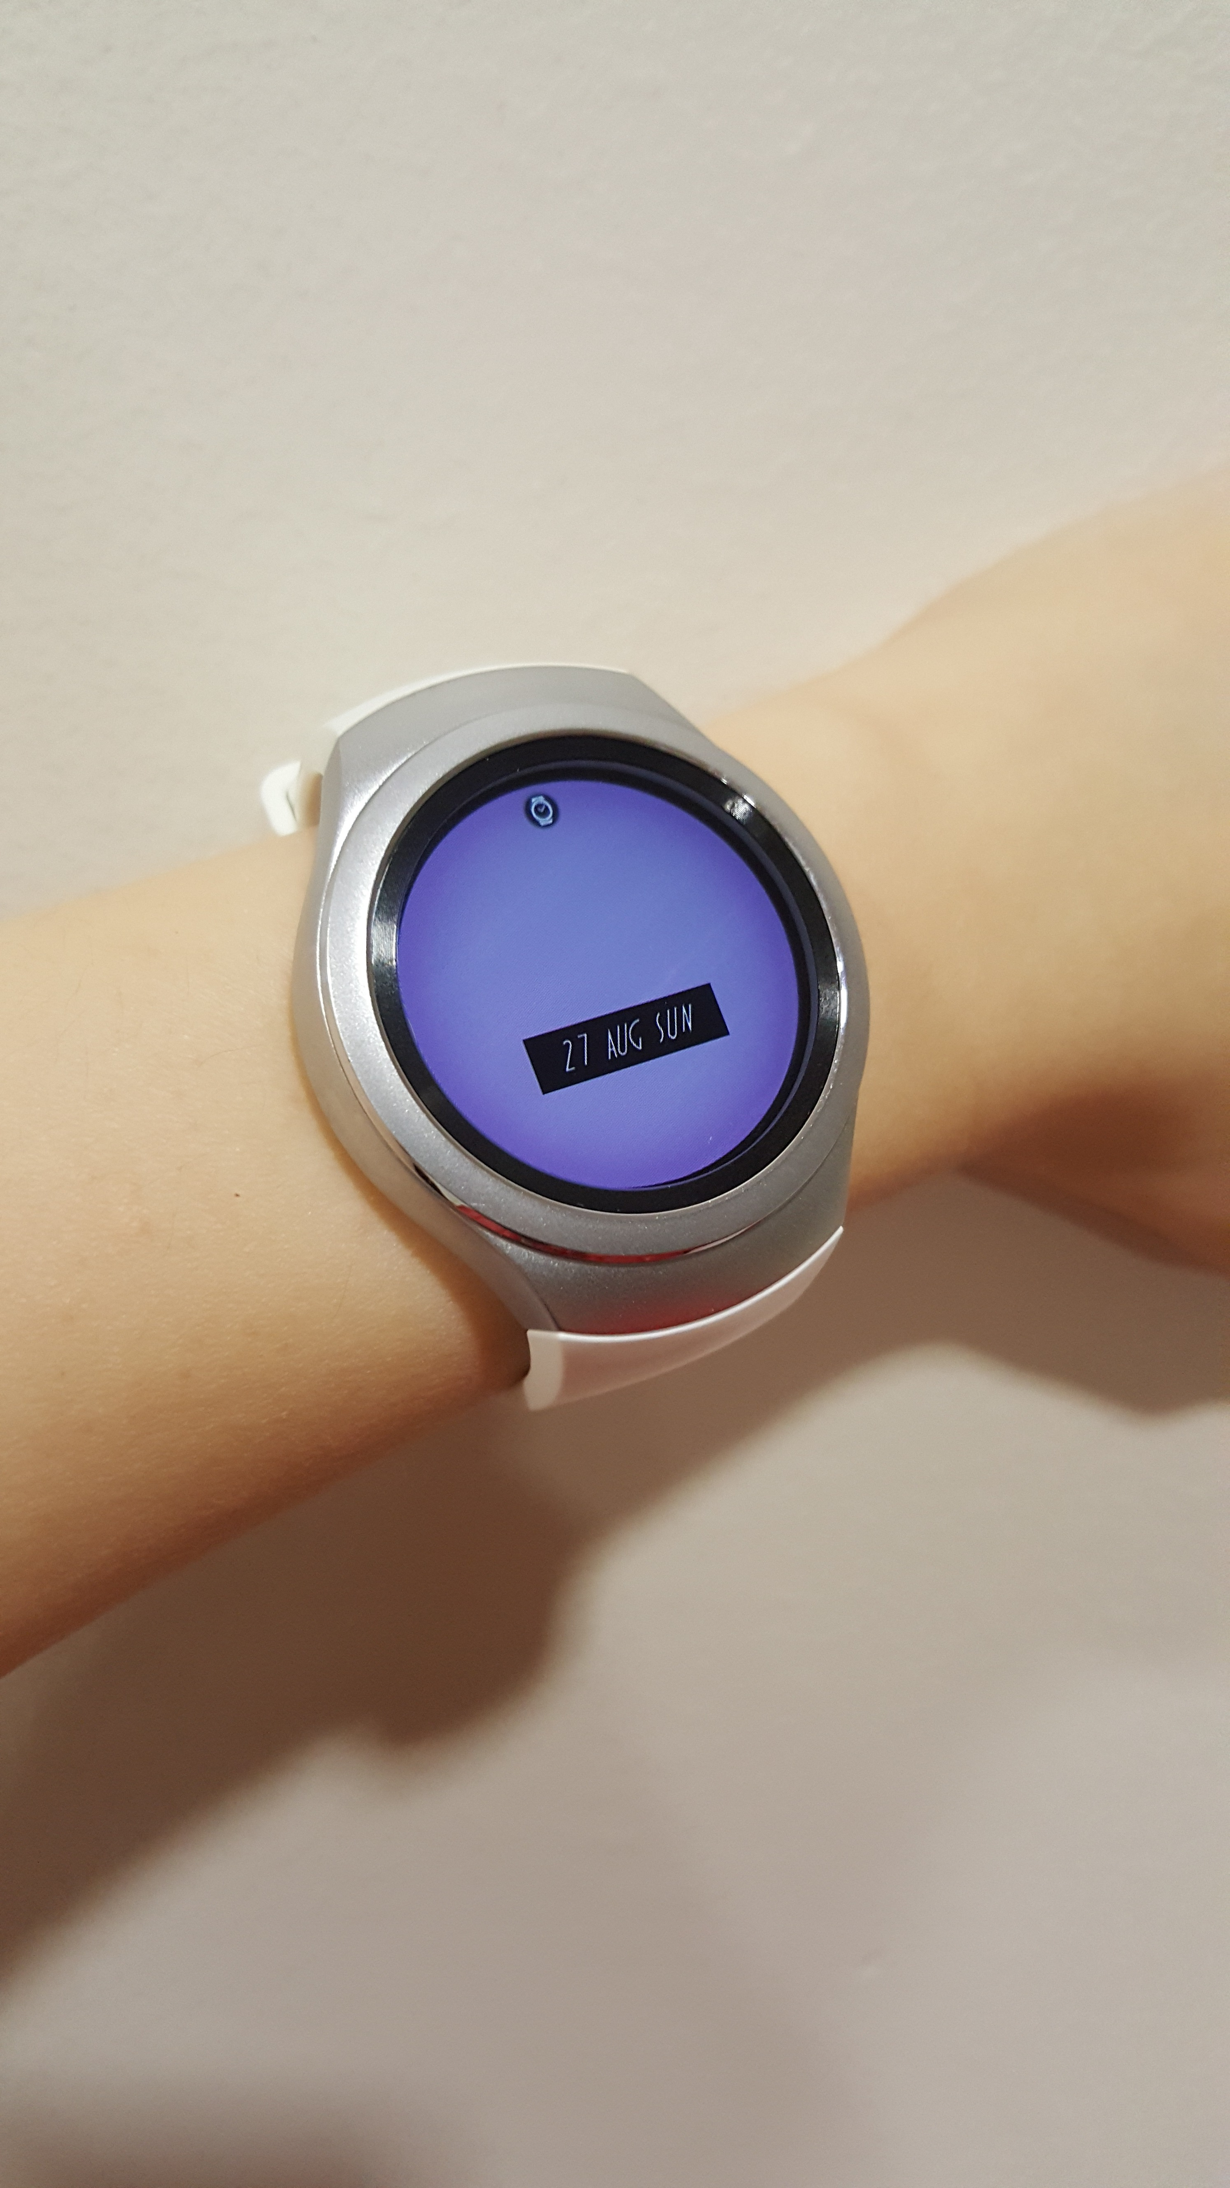
Emotion Recognition from Walking Data

Slide 21
Emotion Recognition from Walking Data
Monty Python
Interstellar
Stimulus
Neutral
Stimulus

Slide 22
Molecular Graph Generation

Slide 23
Molecular Graph Generation
Deep Learning
Molecule
Molecule

Slide 25
Machine Learning in a Nutshell

Slide 26
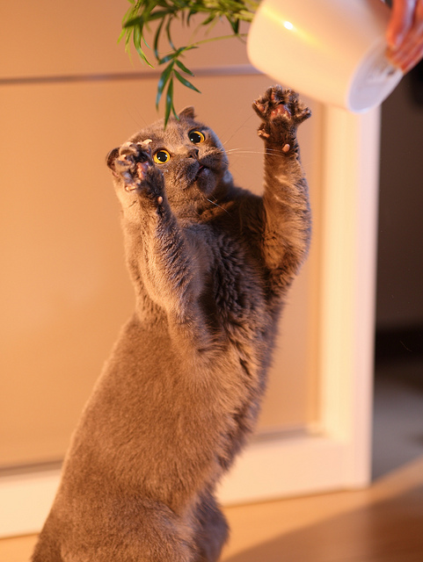
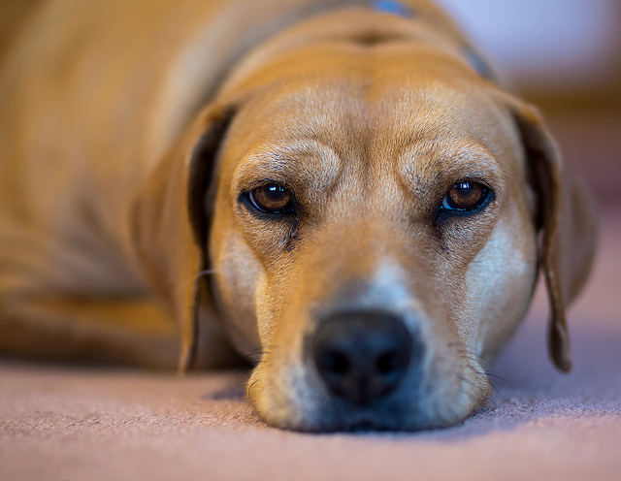
Is this a cat or a dog?

Slide 27


Cat or Dog?
Software 1.0
Software
Program
Cat

Slide 28

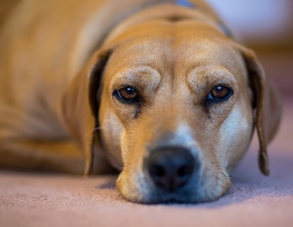
Cat or Dog?
Software 2.0
Cat
Model
Cat/Dog
Dog

Slide 29

Cat or Dog?
Model
Cat

Slide 30
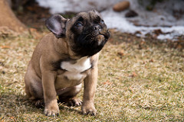
Cat or Dog?
Model
Dog

Slide 31
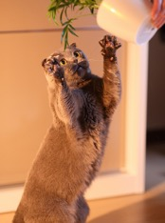

Recipe for Machine Learning
Data
Labels
Model
Cat
Deep
learning
Logistic
regression
Dog
Notes:
So what is the recipe for machine learning? What are the basic elements that you need?
Data, labels for the data, and a model
What is an example of data?
An example of data would be pictures, images.
Second, I need labels for the data. That means a label that says this picture is a cat, this picture is a dog.
Lastly, I need a model that will learn the associations between the data and the labels, and will figure out patterns that differentiate between cats and dogs.
This model could be a logistic regression, which would be an example of a simple model.
Or it could be something complex, such as deep learning.
How many people have heard of deep learning?
So I will talk about deep learning later in the talk.
One of the things I want you to remember, is that deep learning is what has brought machine learning and artificial intelligence into the renaissance we see today. Deep learning has led to an explosion in research and commercial applications, it’s almost a frenzy.

Slide 32
Machine Learning Heaven:
Large dataset with labels

Slide 33
The basics of a machine learning model
”features”
“attributes”
“covariates”
“independent variables”
Model
“outcomes”
“targets”
“dependent variables”

Slide 34
Regression: predicting a number
”features”
“attributes”
“covariates”
“independent variables”
Model
number
1.5, -24.2, 8, 100
Predicting sugar level, depression levels
Notes:
Regression consists of predicting a number.
What comes out of the model is a number
Can anyone think of any examples of regression?

Slide 35
Classification: predicting a category
”features”
“attributes”
“covariates”
“independent variables”
Model
category
cat vs dog
yes vs no
high risk, medium risk, low risk
Predicting whether a patient has cancer, whether a patient is likely to be readmitted
Notes:
Classification consists of predicting a category.
The category can be just two, like cat vs dog, yes vs no, or it can be multiple categories, such as high, medium, and low risk for a disease.

Slide 37
Machine Learning Models

Slide 38
Models
Linear regression
Logistic regression
Decision tree
Random forest
Neural networks

Slide 39
Linear Regression
Predicting length of stay based on age

Slide 40
Logistic Regression
Does the patient have cancer? Yes/no
Will the patient be re-admitted within the next 30 days?

Slide 41
Decision Tree

Slide 42
Random Forest
…
Notes:
What do you think a random forest is?
It consists of multiple trees.
If I take a lot of decision trees, it can be tens, even hundreds of decision trees, then I have a random forest.
A random forest is special because the trees that make up the forest are not identical. They are all slightly different.
It’s almost as if you are trying to amass the power from the masses.

Slide 43
Random Forest

Slide 44
Neural Networks
”features”
“attributes”
“covariates”
“independent variables”
“outcomes”
“targets”
“dependent variables”

Slide 45
Deep Learning
”features”
“attributes”
“covariates”
“independent variables”
“outcomes”
“targets”
“dependent variables”

Slide 47
Recipe for Machine Learning
Data
Labels
Model
Supervised learning
Cat
Models
Dog
Notes:
So what is the recipe for machine learning? What are the basic elements that you need?
Data, labels for the data, and a model
What is an example of data?
An example of data would be pictures, images.
Second, I need labels for the data. That means a label that says this picture is a cat, this picture is a dog.
Lastly, I need a model that will learn the associations between the data and the labels, and will figure out patterns that differentiate between cats and dogs.
This model could be a logistic regression, which would be an example of a simple model.
Or it could be something complex, such as deep learning.
How many people have heard of deep learning?
So I will talk about deep learning later in the talk.
One of the things I want you to remember, is that deep learning is what has brought machine learning and artificial intelligence into the renaissance we see today. Deep learning has led to an explosion in research and commercial applications, it’s almost a frenzy.

Slide 48
Unsupervised Learning
Data
Model
Notes:
So what is the recipe for machine learning? What are the basic elements that you need?
Data, labels for the data, and a model
What is an example of data?
An example of data would be pictures, images.
Second, I need labels for the data. That means a label that says this picture is a cat, this picture is a dog.
Lastly, I need a model that will learn the associations between the data and the labels, and will figure out patterns that differentiate between cats and dogs.
This model could be a logistic regression, which would be an example of a simple model.
Or it could be something complex, such as deep learning.
How many people have heard of deep learning?
So I will talk about deep learning later in the talk.
One of the things I want you to remember, is that deep learning is what has brought machine learning and artificial intelligence into the renaissance we see today. Deep learning has led to an explosion in research and commercial applications, it’s almost a frenzy.

Slide 49
Activity
Come up with an application of machine learning in healthcare
What problem are you trying to solve?
What data will you be analyzing?
What will your model predict?

Slide 51
Machine Learning Challenges (Fails)

Slide 52
Husky vs Wolf Classifier

Slide 53
Snow detector

Slide 54
Adversarial examples

Slide 55
Bias in training

Slide 56
Challenges
Interpretability
Robustness
Bias

Slide 57
Singularity

Slide 58
The development of full artificial intelligence could spell the end of the human race….It would take off on its own, and re-design itself at an ever-increasing rate. Humans, who are limited by slow biological evolution, couldn’t compete and would be superseded.
Stephen Hawking

Slide 59
Yet the biggest harm that AI is likely to do to individuals in the short term is job displacement, as the amount of work we can automate with AI is vastly bigger than before.
Andrew Ng

Slide 60
It’s likely that machines will be smarter than us before the end of the century—not just at chess or trivia questions but at just about everything, from mathematics and engineering to science and medicine.
Gary Marcus

Slide 61
But we are entering an era of hacking humans. And I'd say the most important fact anybody who is alive today needs to know about the 21 century is that we are becoming hackable animals. It starts by having corporations and governments amass enormous amounts of data about where we go, what we search online and what we buy.
Yuval Noah Harari

Slide 62
1-Minute Summary
Machine learning recipe: data + labels + model
Model is math, a mapping from input to output, linear algebra, calculus, probability
Many models: least squares, logistic regression, decision tree, neural networks, deep learning
Machine learning in healthcare is very good for visual tasks

Slide 63
juan.quiroz@mq.edu.au

